Slide 1
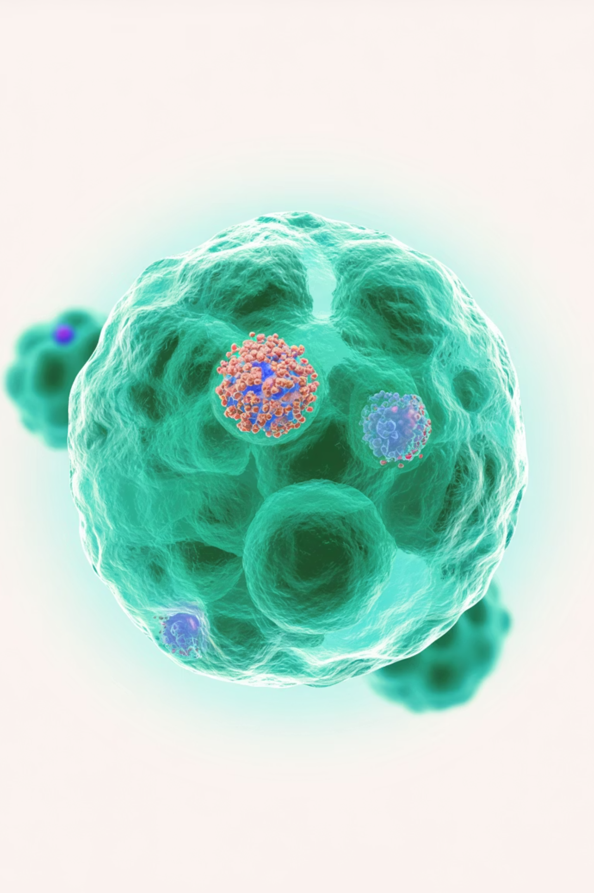



Every Step Counts:
The Final Step in HER2+ Treatment Journey
Neratinib in HER2 positive breast cancer
أ.د. نادر محمد عبدالله
رئيس شـعبة الأورام الطبـية - مستشـفى اللاذقـية الجامعـي
أستاذ في قسم الأورام - كلية الطب البشري – جامعة اللاذقية

Slide 2
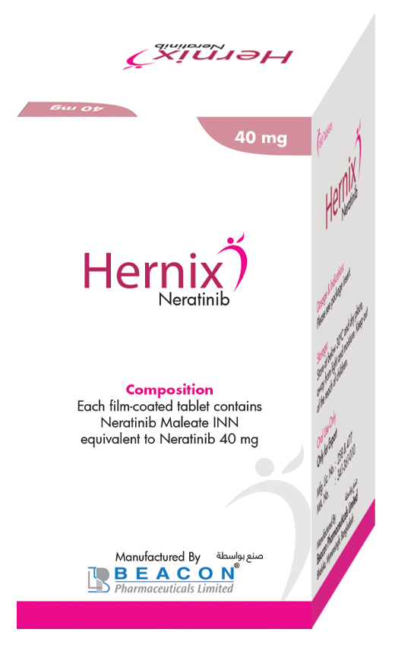

Every Step Counts:
The Final Step in HER2+ Treatment Journey
1
2
3
Key features of HER2+ Breast Cancer
Neratinib in Localized HER2+ Breast Cancer
Neratinib in Metastatic HER2+ Breast Cancer

Slide 3
Key features
of HER2+ Breast Cancer

Slide 4
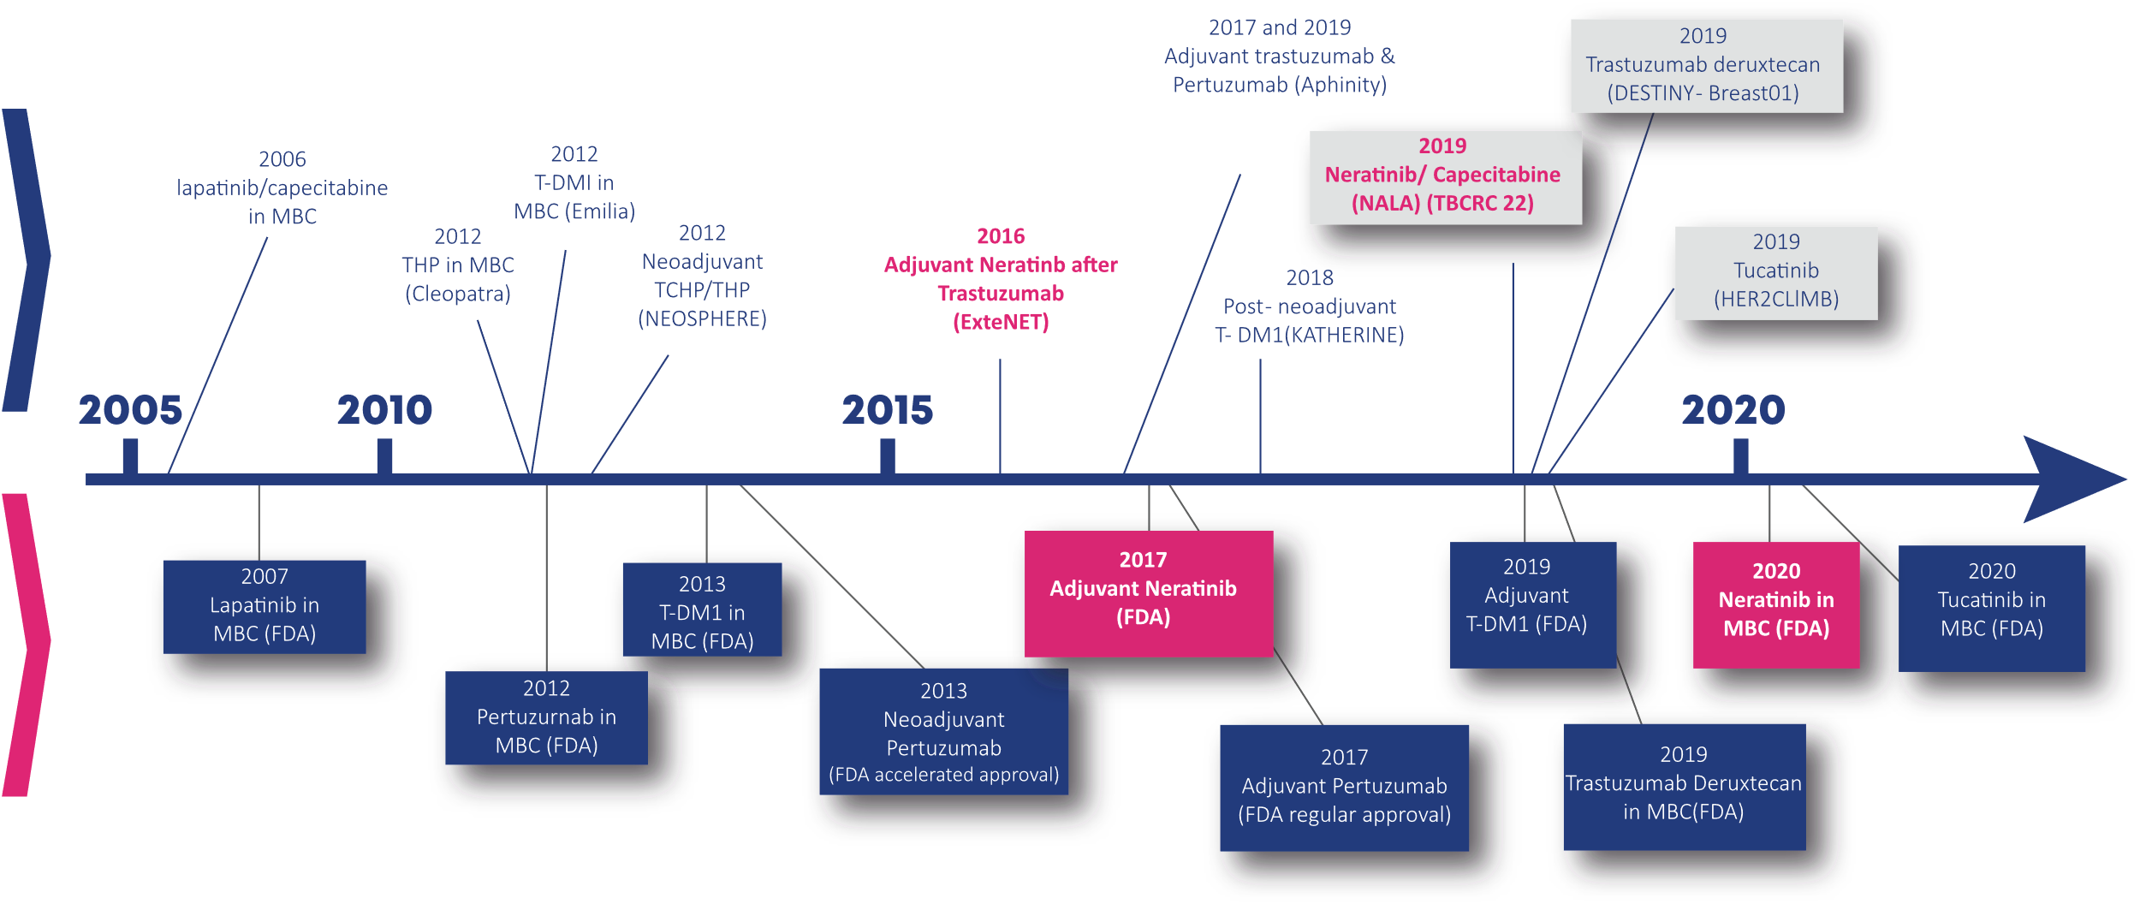



Key features of HER2+ Breast Cancer
~1 in 5 women diagnosed with eBC will have HER2+ disease¹
Up to 1 in 3
median OS
in patients with HER2-positive BC who develop metastatic disease⁴
Women with HER2+ eBC
will still develop mBC, despite current advances in treatment^{2,3}
Disease recurrence, Metastasis, Shortened survival, Rapid tumour development & High nuclear grade
Wolff AC, et al. J Clin Oncol 2013; 31:3997–4014; 2. Jackisch C, et al. SABCS 2015 (Abstract PD5-01); Slamon D, et al. SABCS 2015 (Abstract S5-04); 4. Swain S, et al. N Engl J Med 2015; 372:724-34.

Slide 5
HER2-positive Breast Cancer:
A rapidly evolving landscape
Trastuzumab deruxtecan-pertuzumab DESTINY BREAST 09 2025
Clinical Trials
FDA Approvals
Murthy R, SABCS 2020. Spotlight session 3

Slide 6


NERATINIB
for Localized HER2+ BC

Slide 7




Proposed Strategy for Managing Patients
With Stage I-III HER2+ EBCA
cT1a/b, cN0*
cT1c cN0
≥ cT2 or ≥ cN1
Surgery → trastuzumab-based therapy (observation only; TH followed by H* 1 yr)
Neoadjuvant
TCHP (or AC-THP)
Assess Risk* & Patient Preference
Surgery
HR+: standard endocrine therapy
*High-risk patients (age <35 yrs, grade 3, hormone receptor negative, multifocal disease) could be considered for neoadjuvant therapy.
Residual invasive disease
pCR
(ypT0/is ypN0)
‡In the phase II CONTROL trial assessing the effectiveness of
antidiarrheal prophylaxis for neratinib-induced diarrhea, 54% of patients received pertuzumab as part of (neo)adjuvant therapy prior to extended adjuvant therapy with neratinib.¹
T-DM1 x 14
H (+P if LN+ prior to NAC) x 1 yr
1. Barcenas. Ann Oncol. 2020;31:1223.
Neratinib if HR+ ‡
Notes:
AC, doxorubicin/cyclophosphamide; EBC, early breast cancer; H, trastuzumab; HR, hormone receptor; LN, lymph node; P, pertuzumab; pCR, pathologic CR; TCHP, docetaxel/carboplatin plus trastuzumab and pertuzumab; T-DM1, trastuzumab emtansine; TH, paclitaxel/trastuzumab.

Slide 8
TRAIN-2:
Neoadjuvant CT With or Without Anthracyclines With Dual HER-2 Blockade in HER2+ eBC With Stage I-III
Open-label, randomized, controlled phase III trial
High rate of pCR with or without anthracyclines
Main outcome (pCR) consistent across levels of prespecified subgroups
Tumor stage (0-2 vs 3-4)
cN (negative vs positive)
HR (negative vs positive)
Age (<50 yr vs ≥50 yr)
100
P = .95
80
68%
67%
60
pCR Rate (ypT0/is, ypN0) (%)
40
20
140/206
141/212
0
Van Ramshorst. Lancet Oncol. 2018;19:1630. van der Voort. JAMA Oncol. 2021;7:978.
TCHP
FEC + HP
Notes:
cN, clinical nodal size; FEC, 5-fluorouracil/epirubicin/cyclophosphamide; HP, trastuzumab/pertuzumab; HR, hormone receptor; pCR, pathologic complete response; TCHP, paclitaxel/carboplatin/trastuzumab/pertuzumab; CT, chemotherapy; EBC, early breast cancer

Slide 9
APHINITY:
IDFS with Pertuzumab, Trastuzumab & CT vs Trastuzumab and CT in HER2+ EBC (ITT Population)
Randomized, double-blind, placebo-controlled phase III trial in patients with HER2+ eBC; no prior invasive BC or anticancer tx or RT; N+ any tumor size (no T0) or N0 tumor size >1 cm*
3 Yr
6 Yr
100
94.1%
90.6%
93.2%
80
87.8%
Pertuzumab
(n = 2400)
Placebo
(n = 2404)
60
IDFS (%)
Events, n (%)
Stratified HR (95% Cl)
Median f/u, mo
221 (9.2)
287 (11.9)
40
0.76 (0.64-0.91)
74.1
20
6 yr from randomization
Difference in event-free rate, %
(95% CI for difference)
2.8
(1.0-4.6)
*Or N0 with tumors >0.5 to ≤1 cm and ≥1 of following: histologic/nuclear grade 3; ER negative and PgR negative; aged <35 yr.
N0 enrollment capped after first 3655 patients randomized.
1. von Minckwitz. NJEM. 2017;377:122. 2. Piccart. JCO. 2021;39:1448
0
1
2
3
4
5
6
Patients at Risk, n Pertuzumab Placebo
Yrs
2400 2277 2198 2122 2055 1978 1482
2404 2312 2215 2134 2039 1967 1421
Notes:
AC, doxorubicin/cyclophosphamide; BC, breast cancer; BL, baseline; CT, chemotherapy; DFS, disease-free survival; EBC, early breast cancer; ER, estrogen receptor; FEC, 5-fluorouracil/epirubicin/cyclophosphamide; IDFS, invasive disease–free survival; LVEF, left ventricular ejection fraction; OS, overall survival; PgR, progesterone receptor; QoL, quality of life; RT, radiotherapy; STEEP, Standard Definitions for Efficacy End Points; TH, taxane/trastuzumab; tx, treatment.

Slide 10
KATHERINE:
IDFS with Trastuzumab Emtansine vs Trastuzumab as Adjuvant Therapy for HER2+ EBC
Randomized, open-label phase III trial in patients with HER2+ EBC (cT1-4/N0-3/M0) and residual invasive disease in breast or axillary nodes after neoadjuvant CT + HER2-targeted therapy* at surgery
100
First IDFS Event, % | T-DM1† | T
Any | 12.2 | 22.2
Distant recurrence | 10.5‡ | 15.9‖
Locoregional recurrence | 1.1 | 4.6
Contralateral breast cancer | 0.4 | 1.3
Death without prior event | 0.3 | 0.4
80
60
T-DM1
(n = 743)
91 (12.2)
88.3
Trastuzumab
(n = 743)
165 (22.2)
77.0
IDFS (%)
Events, n (%)
3-yr IDFS, %
40
20
HR: 0.50 (95% CI: 0.39-0.64; P <.001)
0
Patients at Risk, n
T-DM1
Trastuzumab
0
6
12
18
24
30
36
42
48
54
60
Mo
743
743
707
676
681
635
658
594
633
555
561
501
409
342
255
220
142
119
44
38
4
4
CNS events: ‡5.9% vs ‖4.3%.
*Randomization occurred ≤12 wk of surgery; radiotherapy and/or endocrine therapy given per local standards. Minimum of 9 wk of taxane and trastuzumab. †Patients who d/c T-DM1 for toxicity allowed to switch to trastuzumab to complete 14 cycles.
von Minckwitz. NEJM. 2019;380:617.
Notes:
CNS, central nervous system; IDFS, invasive disease–free survival; T, trastuzumab; T-DM1, trastuzumab emtansine.

Slide 11
ExteNET 5-Yr Update:
Neratinib vs Placebo After Adjuvant Trastuzumab in HER2+ eBC
Stratified by hormone receptor status (ER+ and/or PgR+ vs ER- and PgR-), nodal status (0 vs 1-3 vs ≥4), adjuvant trastuzumab regimen (sequential vs concurrent with CT)
1 yr
Patients with HER2+ EBC (stage I-III);
adjuvant trastuzumab completed ≤2 yr before randomization*; N+/- disease or residual disease after neoadjuvant therapy known ER and PgR status
(N = 2840)
Neratinib 240 mg/day PO
(n = 1420)
*Amendment in February 2010 restricted enrollment to patients with N+ disease who completed trastuzumab ≤1 yr before randomization.
Placebo
(n = 1420)
Endocrine therapy given according to local practice
Primary endpoint: IDFS at 2 yr
Primary analysis of 2-yr IDFS rate: Neratinib, 93.9%; placebo, 91.6% (HR: 0.67; 95% CI: 0.50-0.91; P = .0091)
Chan. Lancet Oncol. 2016;17:367. Martin. Lancet Oncol. 2017;18:1688. Chan. Clin Breast Cancer. 2021;21:80.
Notes:
CT, chemotherapy; EBC, early breast cancer; ER, estrogen receptor; IDFS, invasive disease–free survival; PgR, progesterone receptor.

Slide 12
ExteNET 5-Yr Update:
IDFS with Neratinib vs Placebo As Extended Adjuvant Therapy After Trastuzumab in HER2+ EBC
Randomized, double-blind, phase III trial in patients with HER2+ eBC (stage I-III) with adjuvant Trastuzumab completed ≤2 yr before randomization and N+/- disease or residual disease after neoadjuvant therapy*
120 mg/d
160 mg/d
240 mg/d
100
97.9%
94.3%
92.2%
91.2%
90.2%
95.5%
∆2.5%
80
91.7%
90.2%
89.1%
87.7%
60
IDFS (%)
40
Neratinib Placebo
20
HR: 0.73 (95% CI: 0.57-0.92; P = .0083)
0
0
6
12
18
24
30
36
42
48
54
60
Patients at Risk, n
Neratinib
Placebo
Mo
*Amendment in February 2010 restricted enrollment to patients with N+ disease who completed trastuzumab ≤1 yr before randomization.
Martin. Lancet Oncol. 2017;18:1688.
1420
1420
1316 1354
1272 1298
1225 1248
1106 1142
978 1029
965 1011
949 991
938 978
920 958
885 927
Notes:
IDFS, invasive disease–free survival.

Slide 13
ExteNET:
5-Yr IDFS Analysis by Hormone Receptor Status
Hormone Receptor Positive
Hormone Receptor Negative
100
98.1%
95.4%
93.6%
92.6%
100
97.5%
92.8%
90.8%
89.9%
91.2%
88.9%
96.1%
91.7%
89.8%
86.8%
94.7%
91.8%
90.4%
88.8%
80
88.5%
80
89.3%
60
60
IDFS (%)
Neratinib Placebo
IDFS (%)
Neratinib Placebo
40
40
20
20
HR: 0.60 (95% CI: 0.43-0.83)
HR: 0.95 (95% CI: 0.66-1.35)
0
0
0
6
12
18
24
30
36
42
48
54
60
0
6
12
18
24
30
36
42
48
54
60
Mos After Randomization
Mos After Randomization
Patients at Risk, n
Patients at Risk, n
Neratinib Placebo
816 815
757 779
731 750
705 719
642 647
571 581
565 567
558 556
554 551
544 542
532 525
Neratinib Placebo
604 605
559 575
541 548
520 529
464 495
407 448
400 444
391 435
384 427
376 416
362 402
Martin. Lancet Oncol. 2017;18:1688.
Notes:
IDFS, invasive disease–free survival.

Slide 14
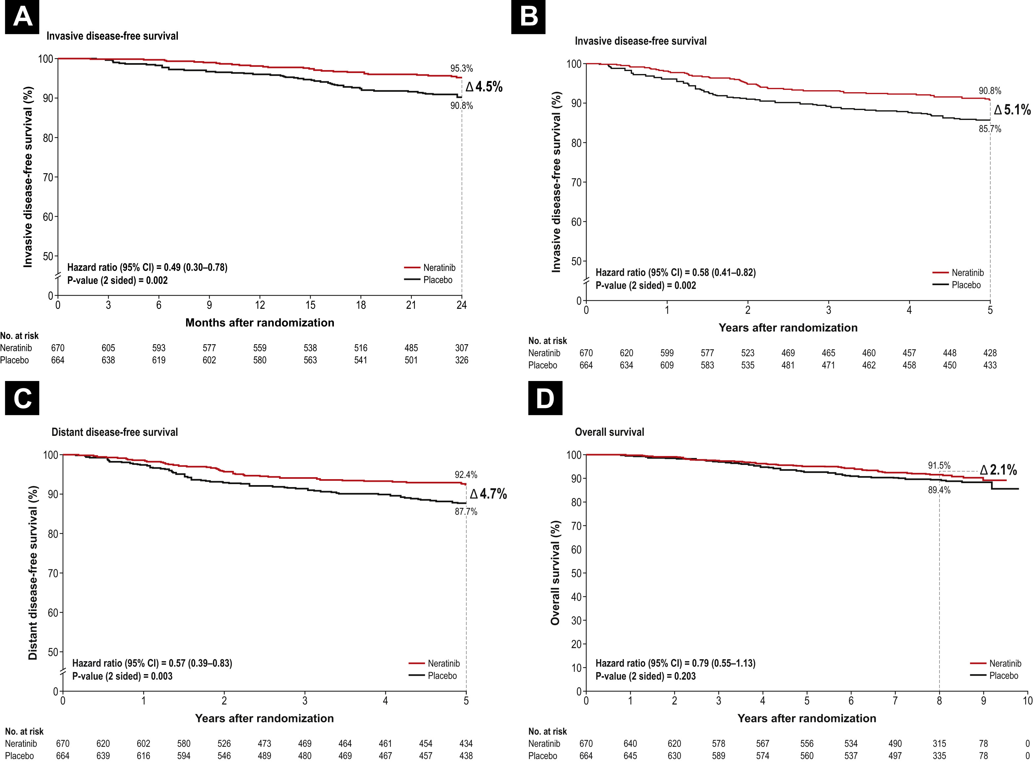
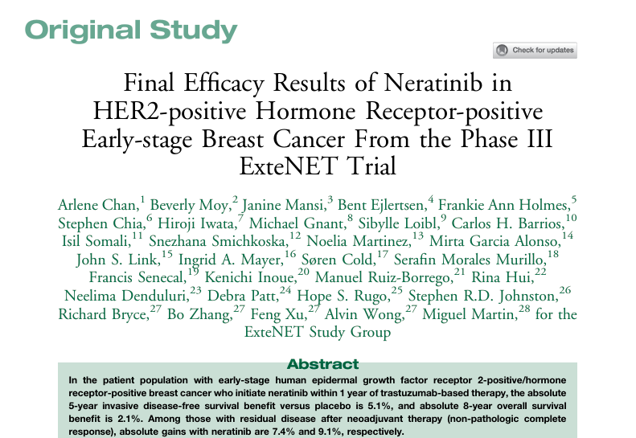


Slide 15
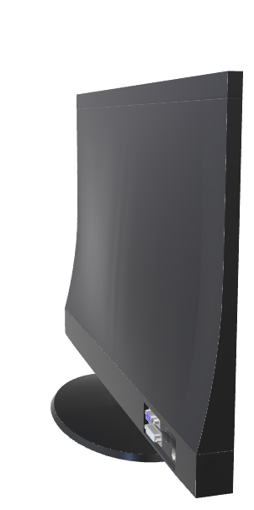
ExteNET:
Invasive Disease-free Survival at 2 years (A) and 5 years (B), Distant Disease-free Survival at 5 years (C), and Overall Survival (D) in the HR+/ ≤1-Year Population (n = 1334)

Slide 16
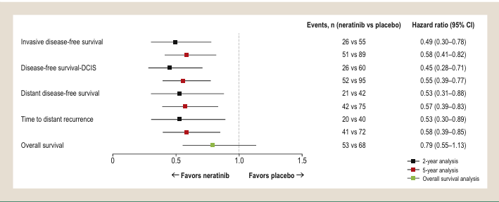
ExteNET:
Invasive Disease-free Survival at 2 years (A) and 5 years (B), Distant Disease-free Survival at 5 years (C), and Overall Survival (D) in the HR+/ ≤1-Year Population (n = 1334)

Slide 17
ExteNET:
Two-year, 5-Year, and Overall Survival Analyses in the HR+/ ≤ 1-Year Population (n = 1334)

Slide 18
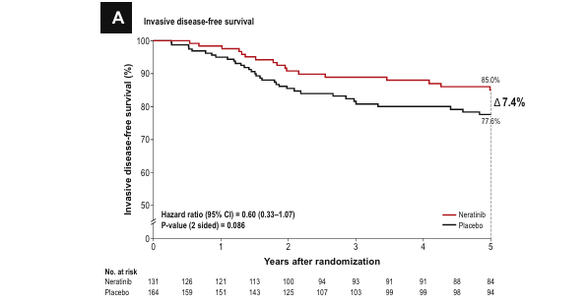
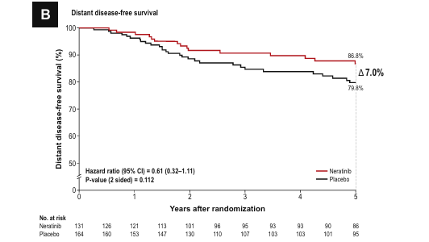
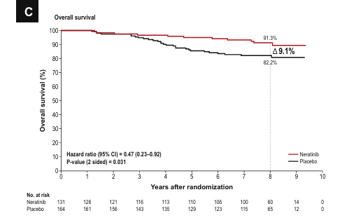
ExteNET:
Invasive Disease-free Survival (A) and Distant Disease-free Survival at 5 years (B), and Overall Survival (C) in the HR+ /≤ 1-Year Population With No pCR after Neoadjuvant Therapy (n = 295)

Slide 19
ExteNET:
Invasive Disease-free Survival (A) and Distant Disease-free Survival at 5 years (B), and Overall Survival (C) in the HR+ /≤ 1-Year Population With No pCR after Neoadjuvant Therapy (n = 295)

Slide 20
Building on Trastuzumab:
Additional HER2-Targeted Therapy in the Adjuvant Setting
Neratinib
Trastuzumab/Pertuzumab
T-DM1
FDA approval July 17, 2017
As extended adjuvant treatment for patients with HER2 overexpressed/ amplified EBC following adjuvant trastuzumab-based therapy¹
FDA approval Dec 20, 2017
Use in combination with chemotherapy as:
Neoadjuvant treatment of patients with HER2+ eBC (either >2 cm tumor or N+)
Adjuvant treatment of patients with HER2+ eBC at high risk of recurrence²
High-risk patients included those with HR- or N+ breast cancer³
FDA approval May 3, 2019
As adjuvant therapy for patients with HER2+ EBC and residual invasive disease after neoadjuvant taxane and trastuzumab-based treatment⁴
1. Neratinib PI. 2. Pertuzumab PI. 3. von Minckwitz G. NEJM. 2017;377:122. 4. Ado-trastuzumab emtansine PI.
Notes:
EBC, early breast cancer; HR, hormone receptor; T-DM1, trastuzumab emtansine.

Slide 21


NERATINIB
IN HER2+ Metastatic BC

Slide 22
Proposed Strategy for Managing Patients
With HER2+ MBC
Pertuzumab + trastuzumab + taxane, with maintenance HP after response
Tucatinib + Trastuzumab + Capecitabine*
Trastuzumab + Docetaxel Or Vinorelbine
T-DXd
Trastuzumab + Paclitaxel ± Carboplatin
T-DM1
Trastuzumab Or Lapatinib + Capecitabine
Trastuzumab + Lapatinib
Multiple lines of concurrent CT with HER2-directed therapy offers clinical benefit for patients with recurrent HER2+ MBC, but optimal sequencing is not known
Neratinib + Capecitabine
Margetuximab + CT (Capecitabine, Eribulin, Gemcitabine, Or Vinorelbine)
*Consider for patients with systemic and CNS progression in third line and beyond (may also be given as second line).
NCCN Clinical Practice Guidelines in Oncology (NCCN Guidelines®) for Breast Cancer V2.2022. © National Comprehensive Cancer Network, Inc 2022. All rights reserved. Accessed March 22, 2022.

Slide 23
CLEOPATRA:
Survival With Pertuzumab, Trastuzumab & Docetaxel in HER2+ MBC
End-of-Study OS in ITT Population*
End-of-Study PFS in ITT Population*
Median OS, Mo
Median PFS, Mo
8 yr
8 yr
100
P + H + D PBO + H + D
57.1
40.8
100
P + H + D PBO + H + D
18.7
12.4
80
80
HR: 0.69 (95% CI: 0.59-0.81)
P = .0001
60
Landmark OS: 37%
Events: 235 (58.5%)
60
OS (%)
PFS (%)
Landmark PFS: 16%
Events: 304 (76%)
40
40
20
HR: 0.69 (95% CI: 0.58-0.82)
P = .0001
Landmark OS: 23%
Events: 280 (69.0%)
20
Landmark PFS: 10%; Events: 329 (81%)
0
0
0
10
20
30
40
50
60
70
80
90
100
110
120
130
0
10
20
30
40
50
60
70
80
90
100
110
120
Mo
Mo
Patients at Risk, n
P + H + D
PBO + H + D
402
406
284 223
179 110
121 76
93 53
71 43
60 35
52 30
43 23
34 21
21 10
6 4
0
0
402
406
371
350
318
289
269
230
228
181
188
149
165
115
150
96
137
88
120
75
71
44
20
11
0
1
0
0
*Crossover patients were analyzed in the placebo arm.
Swain. Lancet Oncol. 2020;21:519.

Slide 24
EMILIA and TH3RESA:
T-DM1 as 2L Therapy for HER2+ MBC After Progression on HER2-Targeted Agents
EMILIA: randomized phase III study of T-DM1 vs Lapatinib + Capecitabine for HER2+ mBC with progression on Trastuzumab + Taxane (N = 991)
TH3RESA: randomized phase III study of T-DM1 vs physician’s choice for HER2+ mBC with progression on Taxane, Lapatinib, and ≥2 HER2-targeted regimens including Trastuzumab (N = 602)
OS
OS
Median OS, Mo
Median OS, Mo
100
T-DM1 Lapatinib + Capecitabine
30.9
25.1
100
T-DM1 Physician’s Choice
22.7
15.8
85.2%
80
80
78.4%
64.7%
60
60
OS (%)
51.8%
OS (%)
40
40
20
20
HR: 0.68 (95% CI: 0.55-0.85; P <.001)
HR: 0.68 (95% CI: 0.54-0.85; P = .0007)
0
0
0
2
4
6
8
10
12
14
16
18
20
22
24
26
28
30
32
34
36
0
2
4
6
8
10
12
14
16
18
20
22
24
26
28
30
32
34
36
38
40
Mo
Mo
Krop. Lancet Oncol. 2017;18:743. Verma. NEJM. 2012;367:1783.

Slide 25
DESTINY-Breast03:
Trastuzumab Deruxtecan vs T-DM1 as Second-line Therapy
100
 | T-DXd (n = 261) | T-DM1 (n = 263)
Median PFS, mo (95% CI) | NR (18.5-NE) | 6.8 (5.6-8.2)
12-mo PFS, % (95% CI) | 75.8 (69.8-80.7) | 34.1 (27.7-40.5)
80
60
HR: 0.28 (95% CI: 0.22-0.37; P = 7.8 x 10⁻²²)
PFS (%)
40
20
0
0
1
2
3
4
5
6
7
8
9
10
11
12
13
14
15
16
17
18
19
20
21
22
23
24
25
26
27
28
29
30
31
32
Mo
T-DXd
T-DM1
261
263
256
252
250
200
244
163
240
155
224
132
214
108
202
96
200
93
183
78
168
65
164
60
150
51
132
43
112
37
105
34
79
29
64
23
53
21
45
16
36
12
29
8
25
6
19
4
10
1
6
1
5
1
3
1
2
1
0
1
1
1
0
Cortes. ESMO 2021. Abstr LBA1. Cortes. N Engl J Med. 2022;386:1143.

Slide 26
HER2CLIMB:
Tucatinib + Trastuzumab + Capecitabine in Previously Treated HER2-Positive MBC
100
Events,
n/N
Median PFS, Mo (95% CI)
1-Yr PFS, % (95% CI)
80
62.9%
Tucatinib + Trastuzumab/Cape Placebo + Trastuzumab/Cape
178/320 97/160
7.8 (7.5-9.6) 5.6 (4.2-7.1)
33 (27-40) 12 (6-21)
60
Patients Alive and Free From Disease Progression (%)
40
46.3%
HR: 0.54 (95% CI: 0.42-0.71; P <.001)
33.1%
46% reduction in risk of disease progression
20
12.3%
0
0
3
6
9
12
15
18
21
24
27
30
33
36
Patients at Risk, n
Tucatinib Arm
Placebo Arm
Mo Since Randomization
320
160
235
94
152
45
98
27
40
6
29
4
15
2
10
1
8
1
4
0
2
0
1
0
0
0
PFS benefit with tucatinib was maintained with longer median follow-up of 29.6 mos, with HR (PFS by investigator assessment): 0.57 (95% CI: 0.47-0.70); P <.00001
Murthy. NEJM. 2020; 382:597. Curigliano. ASCO 2021. Abstr 1043.

Slide 27
HER2CLIMB:
OS in All Patients With Brain Metastases
 | Tucatinib + Trastuzumab/Cape | Placebo + Trastuzumab/Cape
Events/total | 118/198 | 71/93
HR (95% CI) | 0.600 (0.444-0.811; P = .00078)
Median OS, mo (95% CI) | 21.6 (18.1-28.5) | 12.5 (11.2-16.9)
OS: Patients With Brain Metastases
1.0
+
1 Yr
2 Yr
+
+
+
+
+
+
+
+
0.8
+
+
70.0%
+
+
0.6
+
+
48.5%
+
+
+
+
+
+
+
+
+
+
+
+
+
+
+
+
OS Probability
+
+
+
+
+
+
+
+
+
+
+
+
+
+
+
0.4
+
+
+
+
Tucatinib + Trastuzumab/Cape
+
+
50.6%
+
+
+
+
+
+
+
+
+
+
+
+
+
+
+
+
+
+
+
+
+
+
+
+
+
+
+
+
+
+
+
+
0.2
+
+
+
+
+
25.1%
Placebo + Trastuzumab/Cape
+
0.0
0
3
6
9
12
15
18
21
24
27
30
33
36
39
42
45
48
Mo
Tucatinib + Trastuzumab/Cape
Placebo + Trastuzumab/Cape
198 93
183 87
166 76
147 66
131 46
118 40
105 34
92 26
68 17
54 11
36 6
22 5
14 4
9 3
8 0
6 0
2 0
Improved OS benefit with longer follow-up: previous analysis OS 18.1 mo vs 12.0 mo
Lin. SABCS 2021. Abstr PD4.04.

Slide 28
NALA:
Neratinib/Cape vs Lapatinib/Cape in HER2+ mBC With ≥2 Prior Lines of HER2-Targeted Agents
21-day cycle
International, open-label, randomized phase III trial
Stratified by no. prior HER2-targeted therapies, disease location, hormone receptor status, geographic location
Neratinib 240 mg/day PO continuously +
Capecitabine* 1500 mg/m² PO on Days 1-14†
(n = 307)
Patients with centrally confirmed HER2+ MBC; previously treated with ≥2 lines of HER2-targeted agents for MBC; asymptomatic, stable brain metastases allowed (N = 621)
Until PD
Survival follow-up
Lapatinib 1250 mg/day PO continuously +
Capecitabine* 2000 mg/m² PO on Days 1-14
(n = 314)
*BID in 2 evenly divided doses. †Loperamide administered at 4 mg with first neratinib dose followed by 2 mg Q4H for first 3 days, followed by 2 mg every 6-8 hr through end of cycle 1; as needed thereafter.
Secondary endpoints: PFS (locally determined), ORR, DoR, CBR, intervention for CNS metastases, safety, PROs
No endocrine therapy permitted
Coprimary endpoints: OS, PFS (centrally confirmed)
Study positive if either endpoint statistically significant (OS: P <.04; PFS: P <.01)
Saura. JCO. 2020; 38:3138.

Slide 29
NALA:
Survival
International, open-label, randomized phase III trial
PFS (Prespecified Means Analysis)
OS (Coprimary Endpoint)
Mean PFS,
Mo
P Value .0003
Mean OS,
Mo
HR (95% CI) 0.88 (0.72-1.07)
Log-Rank P Value .2086
24.0
22.2
Neratinib + capecitabine Lapatinib + capecitabine
Neratinib + capecitabine Lapatinib + capecitabine
8.8
6.6
1.0
1.0
0.8
0.8
0.6
0.6
Probability of PFS
Restriction: 24 mo
Probability of OS
Restriction: 48 mo
0.4
0.4
0.2
2.2 mo
0.2
1.7 mos
0
0
0
3
6
9
12
15
18
21
24
27
30
33
36
0
3
6
9
12
15
18
21
24
27
30
33
36
39
42
45
48
51
54
57
Patients at Risk, n
N + Cape
L + Cape
Mo Since Randomization
Patients at Risk, n
N + Cape
L + Cape
Mo Since Randomization
307
314
183
183
113
82
69
39
54
24
35
9
20
8
13
3
9
2
7
2
3
2
2
2
2
1
307
314
294
303
275
273
244
240
220
208
182
170
142
132
112
107
82
84
64
67
47
47
34
36
28
27
18
22
15
17
13
12
6
8
4
4
2
3
1
1
Adam Brufsky
Saura. JCO. 2020; 38:3138.

Slide 30
NALA:
CNS-Specific Outcomes in Patients With CNS Metastases at Baseline
100
Time to Intervention for CNS Disease
1.0
CNS-PFS
80
0.8
60
0.6
Lapatinib + capecitabine
Probability of PFS
Cumulative Incidence
Neratinib + capecitabine
40
0.4
Neratinib + capecitabine
20
0.2
Lapatinib + capecitabine
0
0
0
6
12
18
24
30
36
42
48
0
2
4
6
8
10
12
14
16
18
20
22
24
26
Mo Since Randomization
Mo Since Randomization
Patients at Risk, n
Neratinib + capecitabine
Lapatinib + capecitabine
Patients at Risk, n
Neratinib + capecitabine
Lapatinib + capecitabine
51
50
39
34
21
17
10
10
3
4
2
2
1
1
1
0
0
0
51
50
46
36
30
25
17
15
12
10
8
2
5
1
3
1
3
1
1
1
1
1
1
0
1
0
1
0
 | Neratinib + Capecitabine | Lapatinib + Capecitabine
Median CNS-PFS, mo (95% CI) | 12.4 (5.6-17.9) | 8.3 (4.2-NE) | HR: 0.62 (95% CI: 0.32-1.18; P = .143)
12-mo cumulative incidence, % (95% CI) | 25.5 (14.4-38.1) | 36.0 (22.9-49.3) | P = 0.430
Hurvitz. Oncologist. 2021;26e1327.

Slide 31
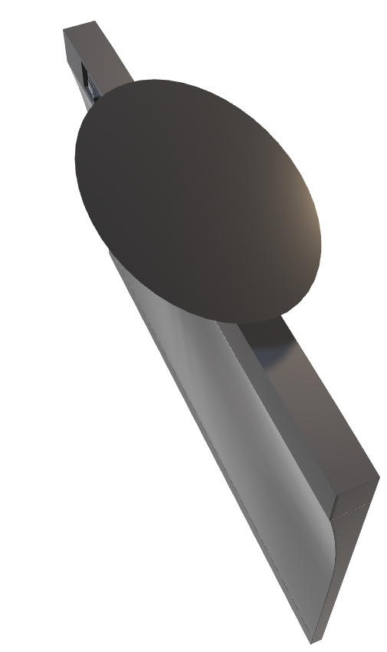
CONTROL:
Key Diarrhea Outcomes (All Cohorts)
Neratinib Dose-escalation Cohorts
35
31%
32%
120 mg/d
160 mg/d
240 mg/d
30
28%
D1-7
D8-14
D9→
26%
25
160 mg/d
200 mg/d
240 mg/d
20%
21%
20
D1-14
D15-28
D29→
Incidence (%)
15
13%
11%
Outcome, n (%) | Neratinib DE Cohort 1 (n = 60) | Neratinib DE Cohort 2 (n = 62)
Grade 1, 2 Grade 3 | 51 (85.0) 8 (13.3) | 45 (72.6) 16 (25.8)
Median time to first onset of grade 3 diarrhea, days | 45 | 20
10
8%
4%
3%
5%
5
0
Loperamide
(n = 137)
Budesonide + Loperamide (n = 64)
Colestipol
+ Loperamide (n = 136)
Colestipol + Loperamide PRN
(n = 104)
DE1 + Loperamide PRN
(n = 60)
DE2 + Loperamide PRN
(n = 62)
Grade 3 diarrhea
D/c due to diarrhea
Ruiz-Borrego. SABCS 2020. Abstr PS13-20.

Slide 32
Considerations for Management of Neratinib-Induced Diarrhea: Prophylaxis
Start Neratinib at Lower Dose and Titrate Up to Help Manage Diarrhea
Neratinib Dose Modifications for Diarrhea
Hold Neratinib for any grade 2 events lasting ≥5 days or grade 3 events lasting ≥2 days or any grade with complicated features*
Wk 1:
120 mg QD
Wk 2:
160 mg QD
Wk 3-52:
240 mg QD
Add loperamide as needed for diarrhea
Resolves to grade ≤1
in ≤7 days
Resolves to grade ≤1
in 8-21 days
Or Use Loperamide at First Dose of Neratinib
Potential to adjust dose if constipation occurs
Time | Loperamide Dose | Dose Frequency
Wk 1-2 | 4 mg | 3 times/day
Wk 3-8 | 4 mg | 2 times/day
Wk 9-52 | 4 mg | As needed to achieve 1-2 BM/day (16 mg/day max)
Resume Neratinib
at same dose
Resume Neratinib
at reduced dose
(200/160/120 mg/day)
If grade 4 diarrhea occurs, treatment delay >3 wk, or if diarrhea recurs at grade ≥2 at 120-mg dose, permanently discontinue neratinib
Add budesonide or colestipol for LPM-refractory diarrhea
*Dehydration, fever, hypotension, renal failure, or grade 3/4 neutropenia.
Neratinib PI.

Slide 33
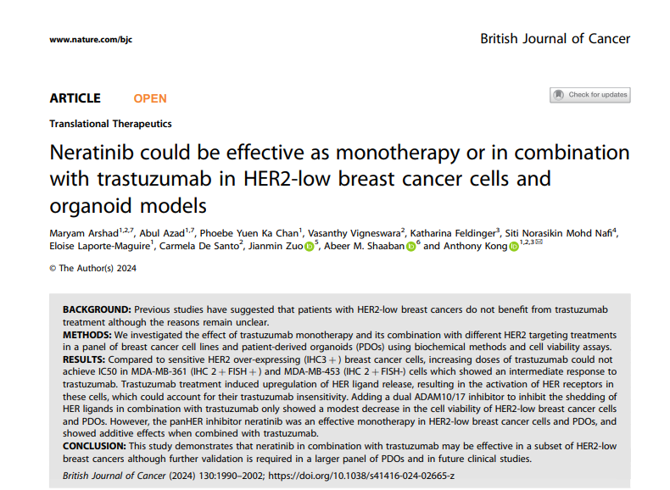

Slide 34








Extend HER therapy,
Extend HER response
40mg Tablets
The Final Step in HER2+ Treatment Journey

Slide 35
The Final Step in HER2+ Treatment Journey

Slide 37
Every Step Counts:
The Final Step in HER2+ Treatment Journey
Thank You
أ.د. نادر محمد عبدالله
رئيس شـعبة الأورام الطبـية - مستشـفى اللاذقـية الجامعـي
أستاذ في قسم الأورام - كلية الطب البشري – جامعة اللاذقية

